Slide 1



Defensive Security Project
by: Matthew Forrest Runa Frye Joshua Bernstein Christopher Lexow Gary Oligschlaeger Miranda Bergman
Frog Squad Security, LLC
Notes:
Welcome, everyone. Today, we're kicking off our presentation on the Defensive Security Project.
we'll delve into our strategies and approaches for enhancing security measures to protect our organization from potential threats. Our focus will be on identifying vulnerabilities, implementing robust defenses, and continuously monitoring our systems to safeguard against attacks.

Slide 2
Table of Contents
This document contains the following resources:
Monitoring Environment
Attack Analysis
Project Summary & Future Mitigations
Notes:
Here’s a quick overview of what we’ll cover:
Monitoring Environment- We’ll start by discussing the tools and technologies we use to monitor our systems.
Attack Analysis- Next, we’ll dive into the details of our attack analysis. This section will examine recent attacks, their impact, and how we analyze attack patterns to improve our defenses.
Project Summary and Future Mitigation- Finally, we’ll wrap up with a summary of our project’s findings and outline our future mitigation strategies.

Slide 3

Monitoring Environment
‹#›

Slide 4
Scenario
We played the role of an SOC analyst at Virtual Space Industries (VSI).
VSI has heard rumors that a rival company, JobeCorp, might initiate cyberattacks to hinder VSI’s business endeavors.
Serving as an SOC analyst, our team was entrusted with monitoring against potential attacks on VSI's systems and applications.
We were tasked with monitoring a Windows operating system, which runs many of VSI's back-end operations, and an Apache web server, which hosts the administrative webpage.
VSI provided us with Windows server logs and Apache server logs to analyze in Splunk.
Notes:
Recently, we have received rumors indicating that a rival company, JobeCorp, may be planning cyberattacks aimed at undermining VSI’s business initiatives. As SOC's for VSI, our primary responsibility has been to monitor and defend against possible attacks targeting VSI's systems and applications. Specifically, we focus on two key components of our infrastructure: the Windows operating system that runs many of our back-end operations and the Apache web server that hosts our administrative webpage. Our team has been tasked with analyzing logs from both the Windows server and the Apache server, utilizing Splunk to process and scrutinize these logs. This allows us to identify any suspicious activity or potential breaches.

Slide 5
Splunk Add-On for Microsoft Windows
‹#›

Slide 6
Splunk Add-on for Microsoft Windows
The Splunk Add-on for Windows allows a Splunk software administrator to collect:
CPU, disk, I/O, memory, log, configuration, and user data with data inputs.
Active Directory and DNS debug logs from Windows hosts that act as domain controllers for a supported version of a Windows Server. You must configure Active Directory audit policy since Active Directory does not log certain events by default.
Domain Name Server debug logs from Windows hosts that run a Windows DNS Server. Windows DNS Server does not log certain events by default, and you must enable debug logging.
Source: https://docs.splunk.com/Documentation/AddOns/released/Windows/AbouttheSplunkAdd-onforWindows
Notes:
Central Processing Unit, .. input/ouput. xtra:

Slide 7
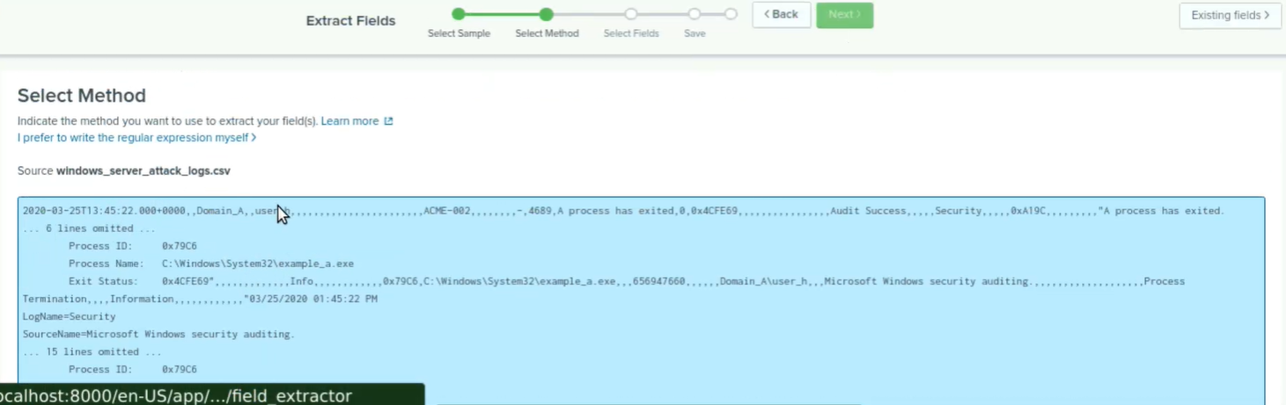
Splunk Add-on for Microsoft Windows
This app provides further insight into data pertaining to Windows Active Directory and DNS servers, while utilizing the same user-friendly interface Splunk.

Slide 8
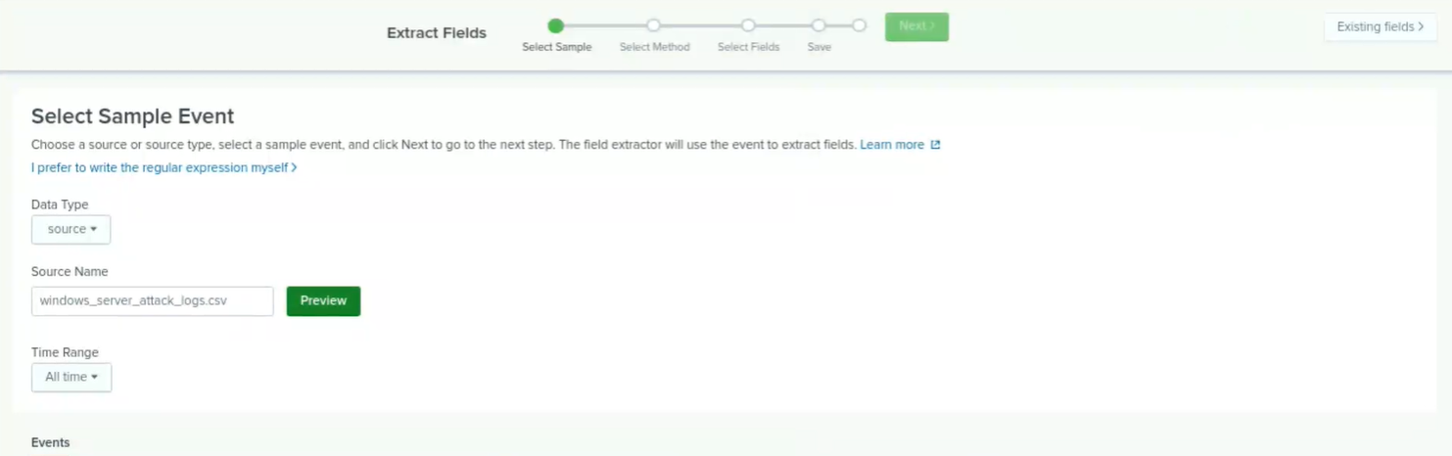
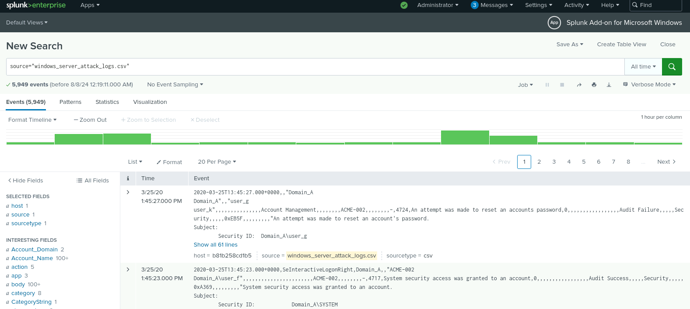
Splunk Add-on for Microsoft Windows
Notes:
top screenshots incredibly user-friendly, below similar interface as normal splunk - compatible with other Splunk Apps such as the Splunk App for Windows Infrastructure, and the Splunk App for Microsoft Exchange

Slide 9
Logs Analyzed
Windows Logs
Apache Logs
1
2
Windows logs contain details about events that occur on the system, such as user and computer account management, logins, sensitive privilege use, event success/failure, and event severity.
Apache logs contain information about HTTP requests and responses such as method, referer domain, status, client IP, and user agent data.
Notes:
We were given to different logs to monitor from VSI. The Windows logs, which contained the events that involved users, account management, logins, etc. The Apache logs contain info about HTTP requests and responses for the VSI website.

Slide 10
Windows Logs
‹#›

Slide 11
Reports: Windows
Designed the following reports:
Report Name | Report Description
VSI Signatures/Signature IDs Table | Shows the ID number associated with the specific signature for Windows activity
Severity Level, Count, and Percentage | Displays the severity levels of logs, the count of each severity, and the percentage
VSI Success/Failure Comparison | A comparison of successful and failed activities on Windows
Notes:
Multiple reports were created to monitor different events that occur on the Windows server. Reports were created to monitor signatures and associated IDs, the severity levels of the events, and if events were successful or failed.

Slide 12
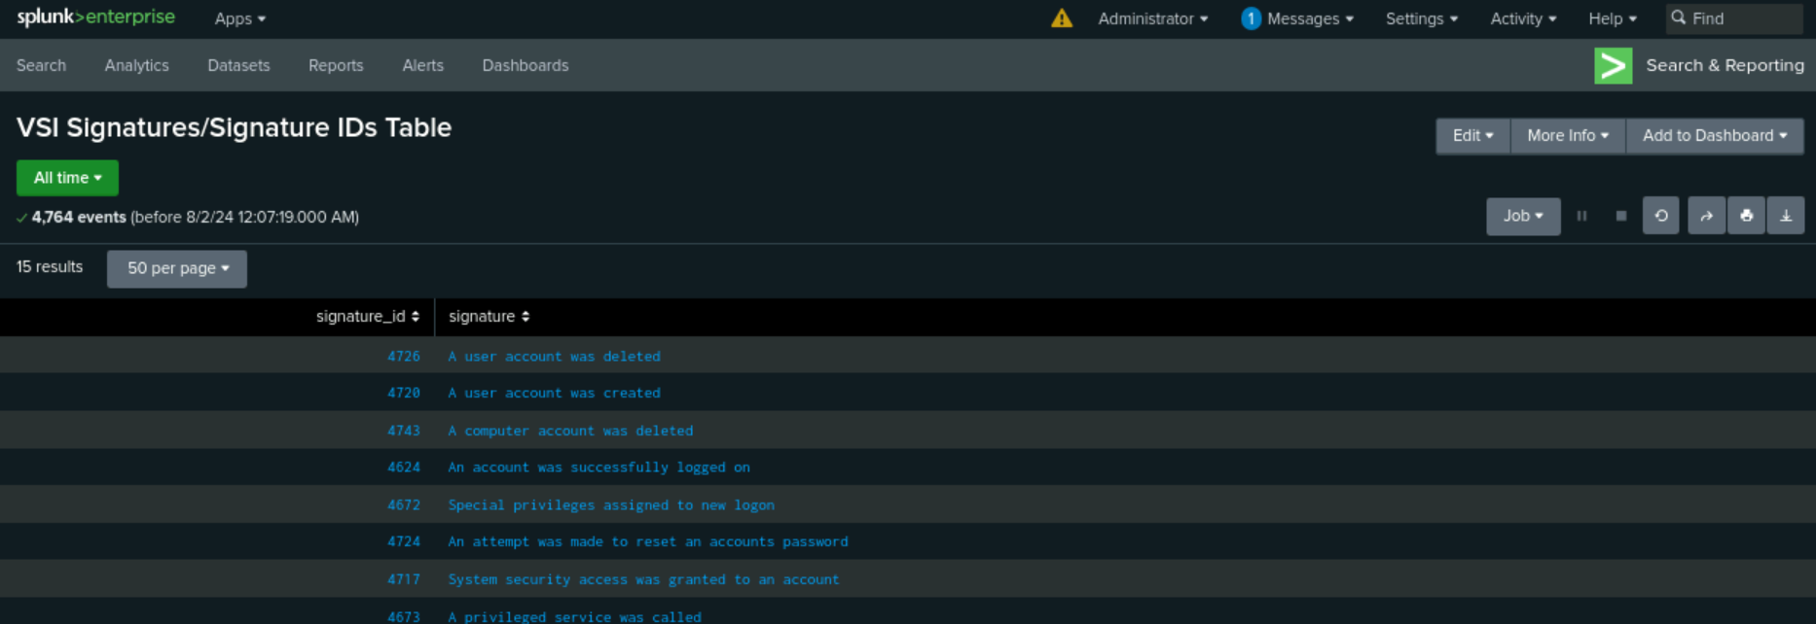
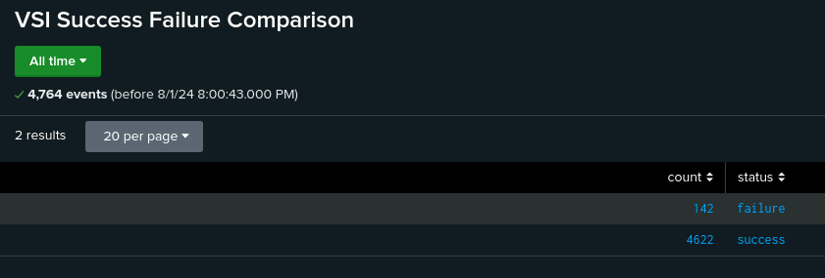
Images of Reports: Windows
Report Image
Report Image
Report Image
Notes:
The following images are screenshots of the reports created.

Slide 13
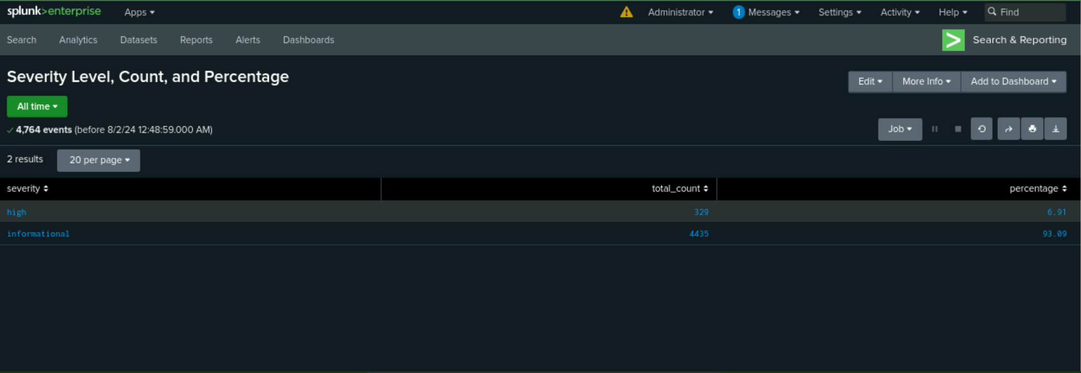

Slide 14
Alerts: Windows
Designed the following alerts:
Alert Name | Alert Description | Alert Baseline | Alert Threshold
Failed Windows Activity Alert | An email alert triggered when the threshold for failed Windows activities has been reached | 5 | 7
JUSTIFICATION: We determined the average number of failed Windows activities per hour is 5. We set the alert threshold at 7 to reduce the potential for false positives.
Notes:
To better monitor the events of the Windows server alerts were created to notify SOC of any suspicious activity. the first alert created was to monitor any failed windows activity.

Slide 15
Alerts: Windows
Designed the following alerts:
Alert Name | Alert Description | Alert Baseline | Alert Threshold
Successful Windows Logon Alert | An email alert triggered when the hourly threshold of successful logons is reached | 13 | 17
JUSTIFICATION: We determined the average number of successful logons per hour is 13. We set the alert threshold at 17 to reduce the potential for false positives.
Notes:
An alert was created to monitor successful logins.

Slide 16
Alerts: Windows
Designed the following alerts:
Alert Name | Alert Description | Alert Baseline | Alert Threshold
User Account Deletion Alert | An email alert triggered when the hourly threshold of deleted user accounts has been reached | 12 | 16
JUSTIFICATION: We determined the average number of successful Account Deletions was 12. We set the alert threshold at 16 to reduce the potential for false positives.
Notes:
An alert was created to monitor account deletions.

Slide 17
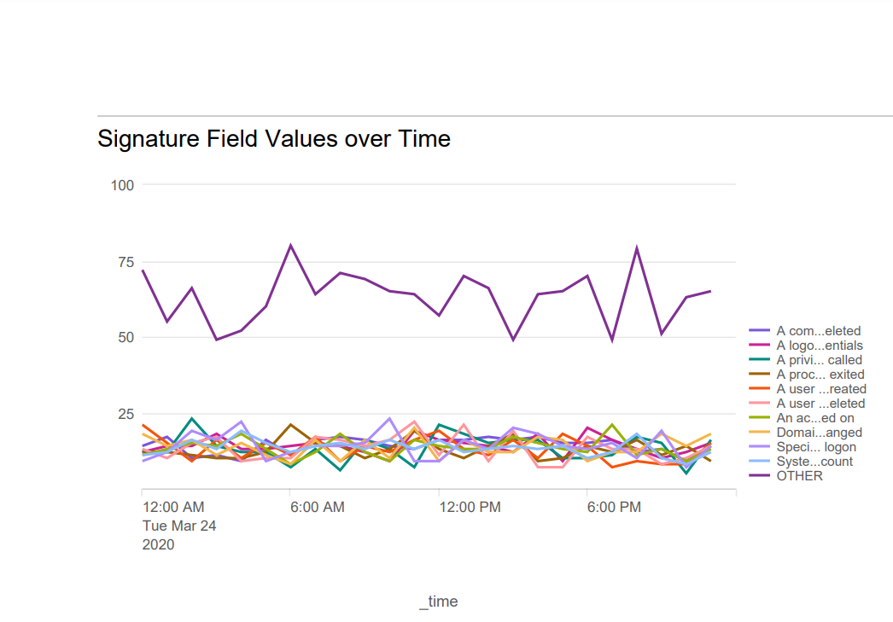
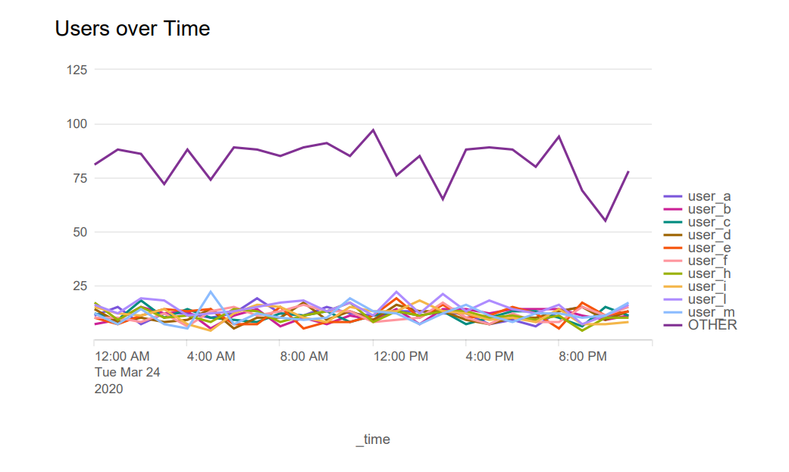
Dashboards: Windows
Place image here
Place image here
Notes:
A dashboard with multiple visualizations was created to better understand the data from the logs. The first two show the different signature fields and users over time.

Slide 18
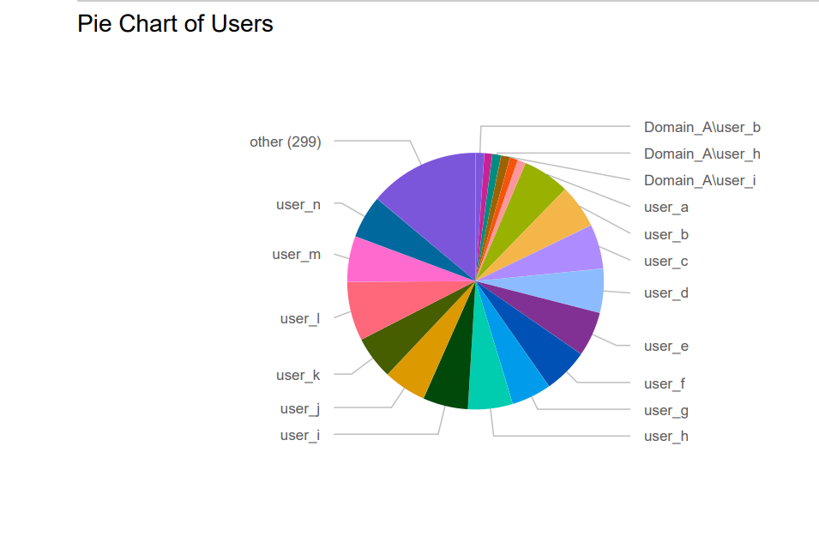
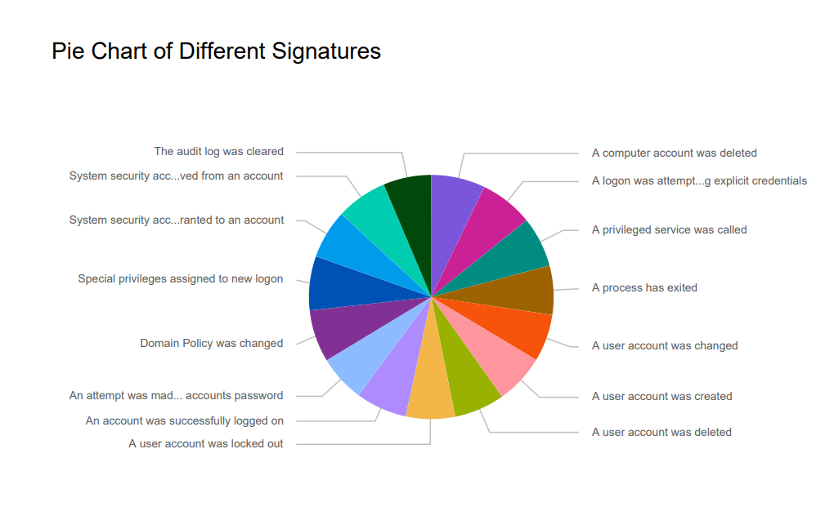
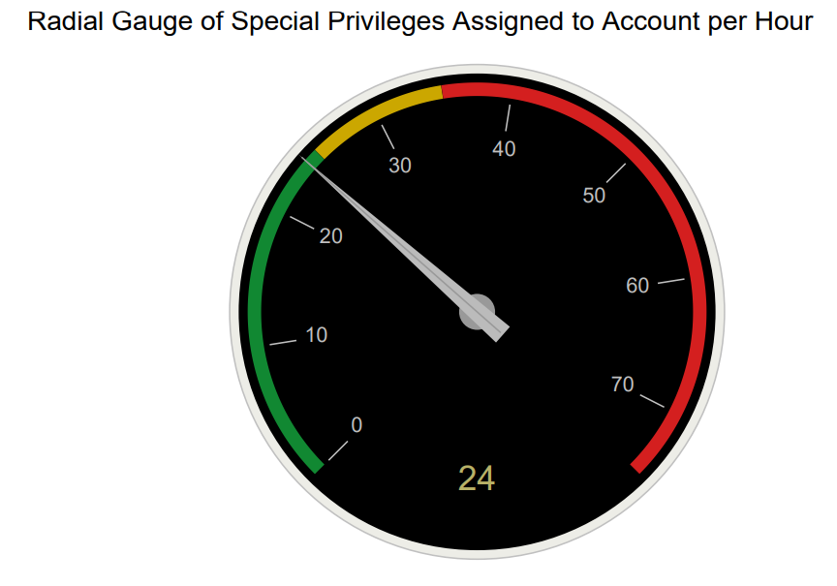
Dashboards: Windows
Place image here
Place image here
Notes:
The two pie charts are visualizations the corroborate the information gather in the time charts. And the radial gauge shows the occurrences of special privileges assigned to accounts. If there is an attack, we felt it would be in VSI’s best interest to know if special privileges were added to accounts that previously did not have privileges.

Slide 19
Apache Logs
‹#›

Slide 20
Reports: Apache
Designed the following reports:
Report Name | Report Description
VSI HTTP Requests | HTTP activity against VSI's web server
VSI Top 10 Domains | Top 10 domains that refer to VSI's website
VSI HTTP Response Code Count | Count of HTTP response codes

Slide 21
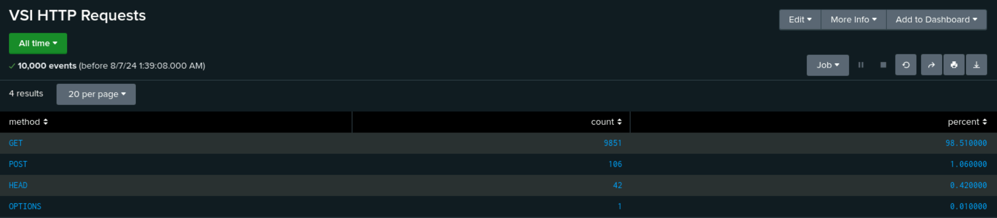
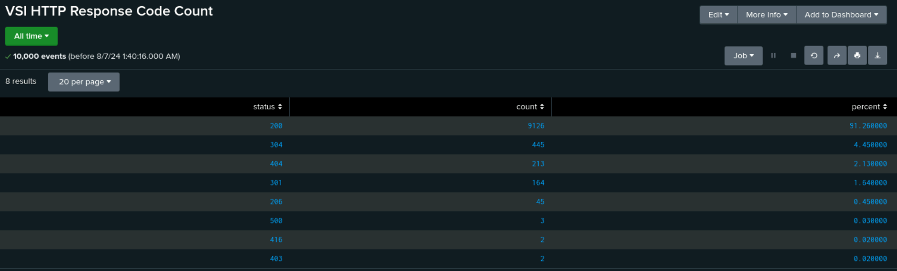
Images of Reports: Apache

Slide 22
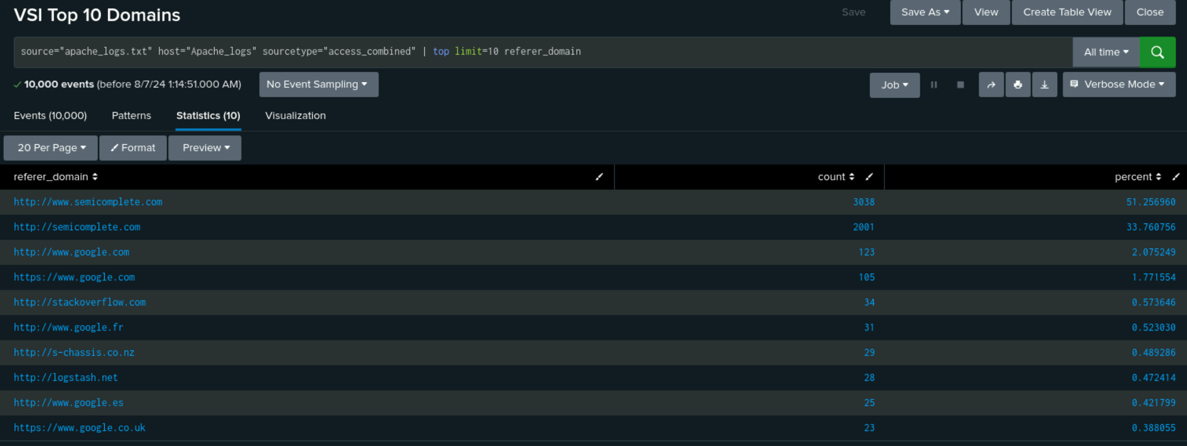
Apache Reports Images Cont

Slide 23
Alerts: Apache
Designed the following alerts:
Alert Name | Alert Description | Alert Baseline | Alert Threshold
Non-U.S. Activity Alert | An email alert triggered when the threshold for activity outside the U.S. is reached | 95 | 120
JUSTIFICATION: We determined an average of 95 for activity from IP addresses outside the U.S. Since there were several outliers ranging from 110-120, we chose 120 as the threshold to reduce the possibility of false alerts.

Slide 24
Alerts: Apache
Designed the following alerts:
Alert Name | Alert Description | Alert Baseline | Alert Threshold
HTTP POST Threshold Alert | An email alert triggered when the threshold for HTTP POST requests is reached | 3 | 5
JUSTIFICATION: The majority of HTTP POST requests per hour ranged from 0-3, with single outliers of 4 and 7. We determined a threshold of 5 to reduce the possibility of false alerts.

Slide 25
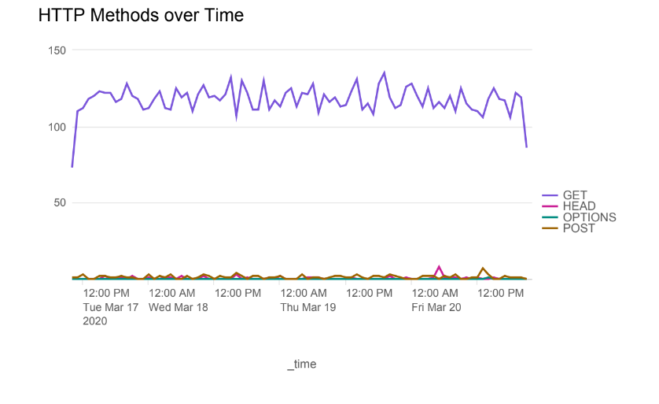
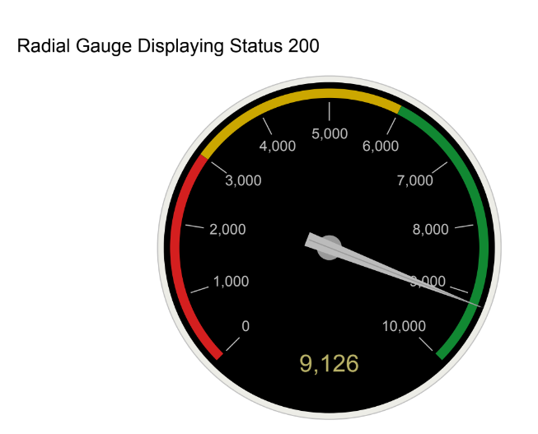
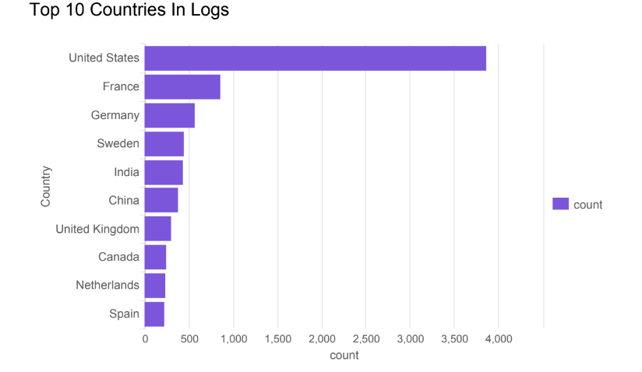
Dashboard: Apache Web Server Monitoring
Place image here

Slide 26
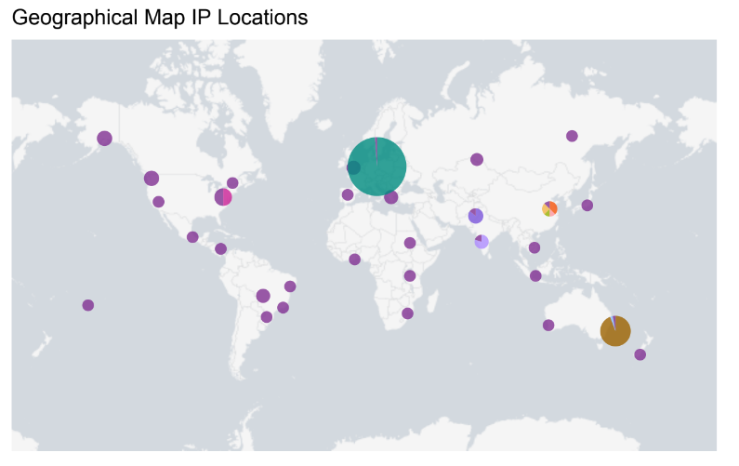

Slide 27
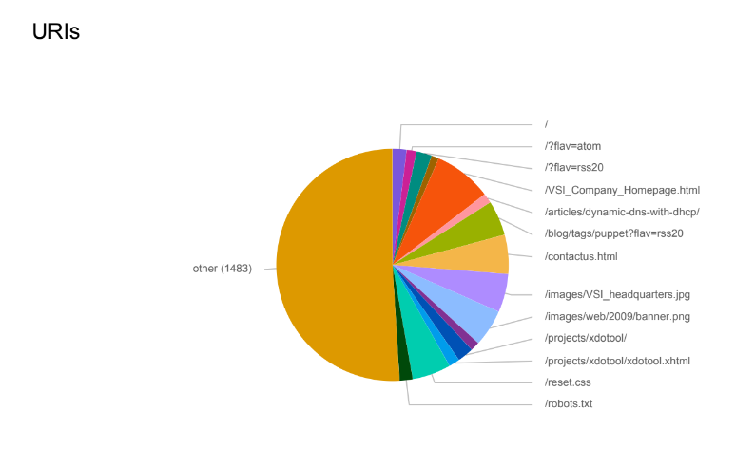
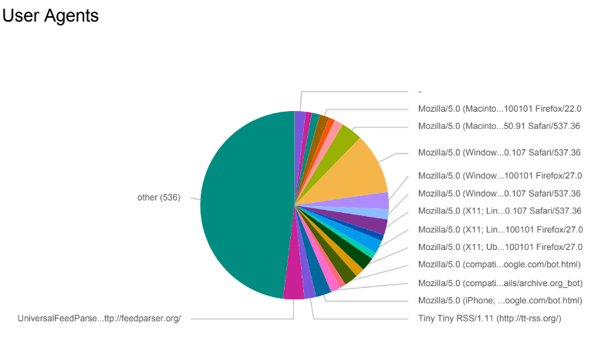
Dashboard: Apache Web Server Monitoring

Slide 28
Attack Analysis for Windows
‹#›
Notes:
Going into our attack analysis for Windows…

Slide 29
Windows Attack Summary Observations
Severity Level Report:
an increase for the severity level
6% to 20%
Windows Success/Failure Report:
increase in successful windows activity
from 4622 to 5856
decrease in failed Windows activity
from 142 to 96
Notes:
We observed… that the “” Report

Slide 30
Windows Attack Summary: Alerts
Failed Windows Logins Alert
detected suspicious activity on March 25, 2020 at 8:00 am
the alert triggered when 35 events occurred within that hour
Successful Windows Logins Alert
detected suspicious activity on March 25, 2020 from 10:00pm - 12:00am
The alert triggered when:
23 logins occurred at 10:00pm
196 logins occurred at 11:00pm
77 logins occurred at 12:00am
We found that “user_j” was the primary user logging in
The thresholds we created were accurate and correctly detected suspicious behavior while mitigating any false positives.
Notes:
That brings us into our Windows Attack Summary Alerts

Slide 31
Windows Attack Summary
Observations from 2 timechart visuals:
a significant increase in 2 signature values & the user activity was identified
signature values that stood out:
“A user account was locked out”
peak at 2am
“An attempt was made to reset an account’s password”
peak at 9am
user activity identification:
user_a corresponds with “A user account was locked out”
peaked at 984 events
user_k corresponds with “An attempt was made to reset an account’s password”
peaked at 1256 events
Notes:
observations from our windows attack timechart visuals indicate

Slide 32
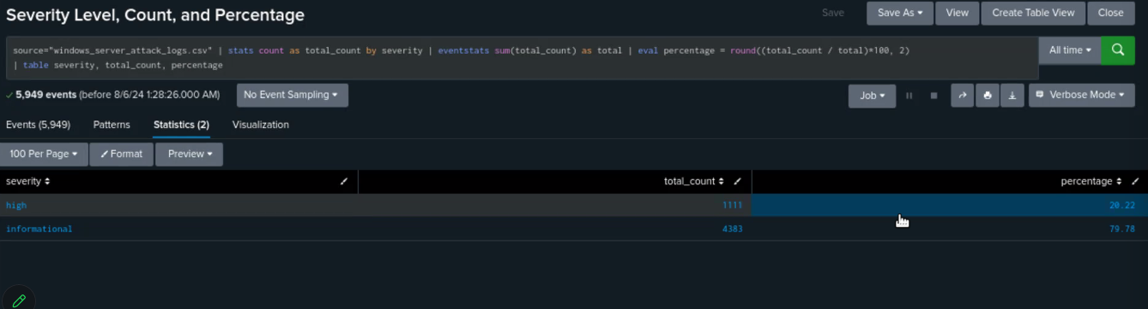
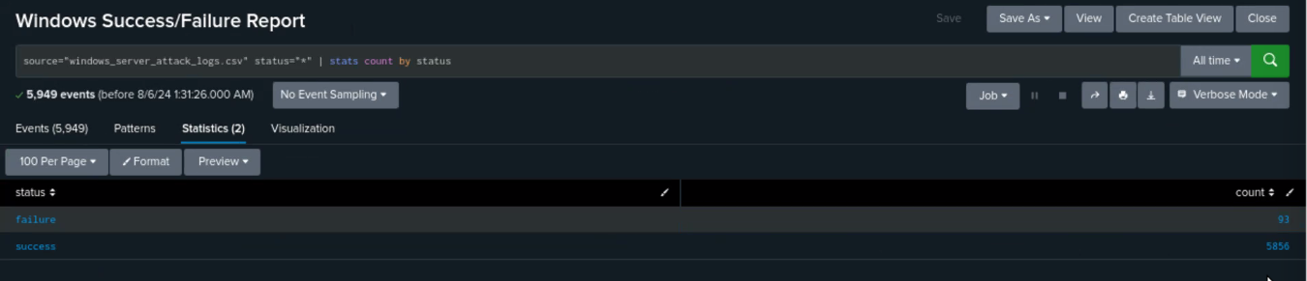
Screenshots of Windows Attack Logs
[Optional: Place images that illustrate attack findings here.]
Notes:
up top you can see a screenshot of the total count & percentage by severity levels, below you can see the screenshot for status success & failure

Slide 33
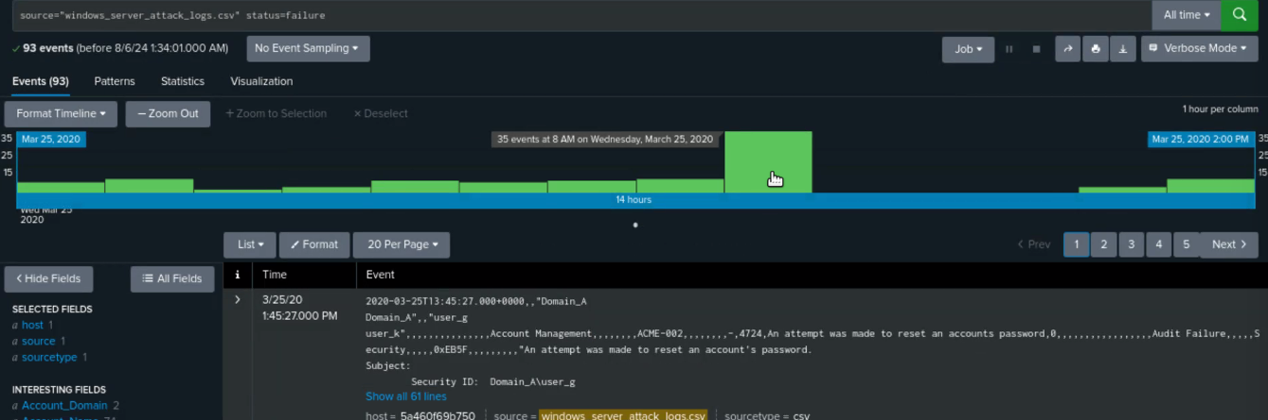
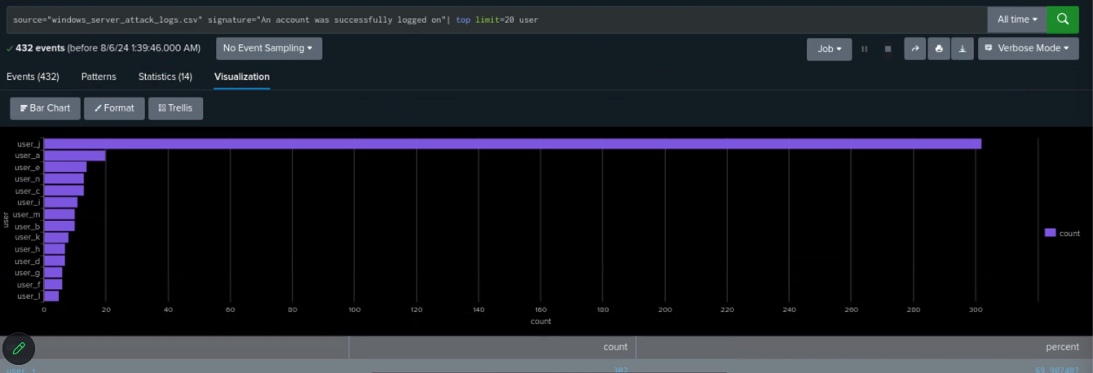
Screenshots of Windows Attack Logs
Notes:
above you can see the screenshot of the 35 events which triggered our failed logins alert, & below you can see that user_j was our most active user with signature “an account was successfully logged on”

Slide 34
Apache Attack Summary
Summarize your findings from your reports when analyzing the attack logs.
From Non-US activity, we had a peak of attacks at 8pm on March 25 2020 with a total of attacks for that hour at 937. And the start of the attacks happening at 7pm with a total for that hour at 81.
From HTTP POST activity, we had a peak of request at 8pm on March 25 2020 with a total of requests of 1296.
Notes:
In our analysis of attack logs, we observed a notable peak in non-US activity on March 25, 2020. Attacks surged to 937 at 8 p.m., following a lower volume of 81 attacks starting at 7 p.m.
For HTTP POST activity on the same day, the peak request volume also occurred at 8 p.m., with a total of 1,296 requests.
This data highlights a significant increase in attack and request activity during that hour.

Slide 35
Apache Attack Summary
Summarize your findings from your alerts when analyzing the attack logs. Were the thresholds correct?
The alert for Non-US activity detected suspicious activity on March 25, 2020 at 8am. It triggered when 937 attacks occurred that hour.
The alert for HTTP POST activity detected suspicious activity on March 25, 2020 at 8am. It triggered when 1296 posts occurred that hour
Notes:
The alert for Non-US activity detected a spike in suspicious behavior at 8 a.m., which was the hour with the highest number of attacks, totaling 937. Similarly, the HTTP POST activity alert also went off at a.m. when there were 1,296 POST requests.
Based on these findings, it seems that the thresholds for triggering our alerts were set correctly, as both alerts activated during significant spikes in activity.

Slide 36
Apache Attack Summary
From the Non-US activity on an average day, the normal activity was between 80 to 120 server views per hour. A spike of 937 occurred at 8pm on March 25, 2020
From the HTTP POST activity on an average day, the normal POST requests were between 0-3 per hour. At 8pm on March 25, 2020 the POST requests jumped to 1296.
Notes:
On a typical day, Non-US activity averages between 80 to 120 server views per hour. However, on March 25, 2020, there was a dramatic spike to 937 server views at 8 p.m.
Similarly, HTTP POST requests usually range from 2 to 4 per hour. On the same day, POST requests surged to 1,296 at 8 p.m.
These spikes indicate significant anomalies compared to normal activity levels.

Slide 37
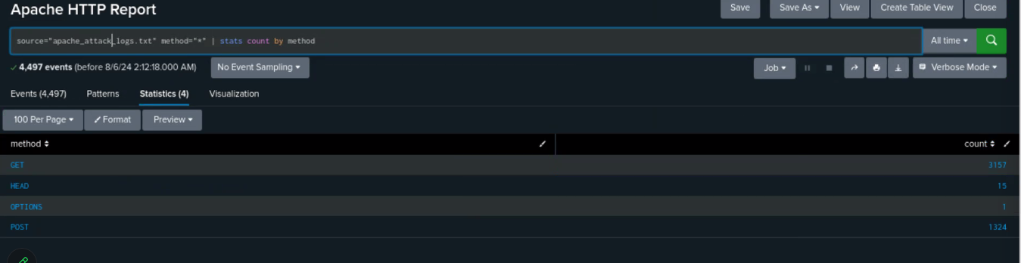
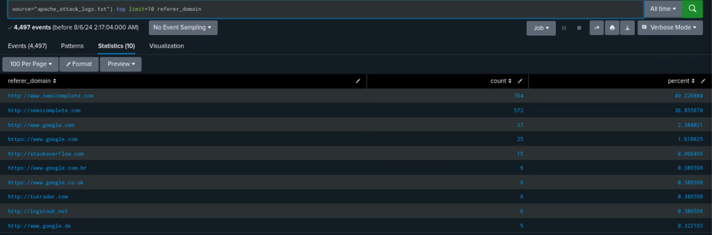
Screenshots of Apache Attack Logs
[Optional: Place images that illustrate attack findings here.]

Slide 38
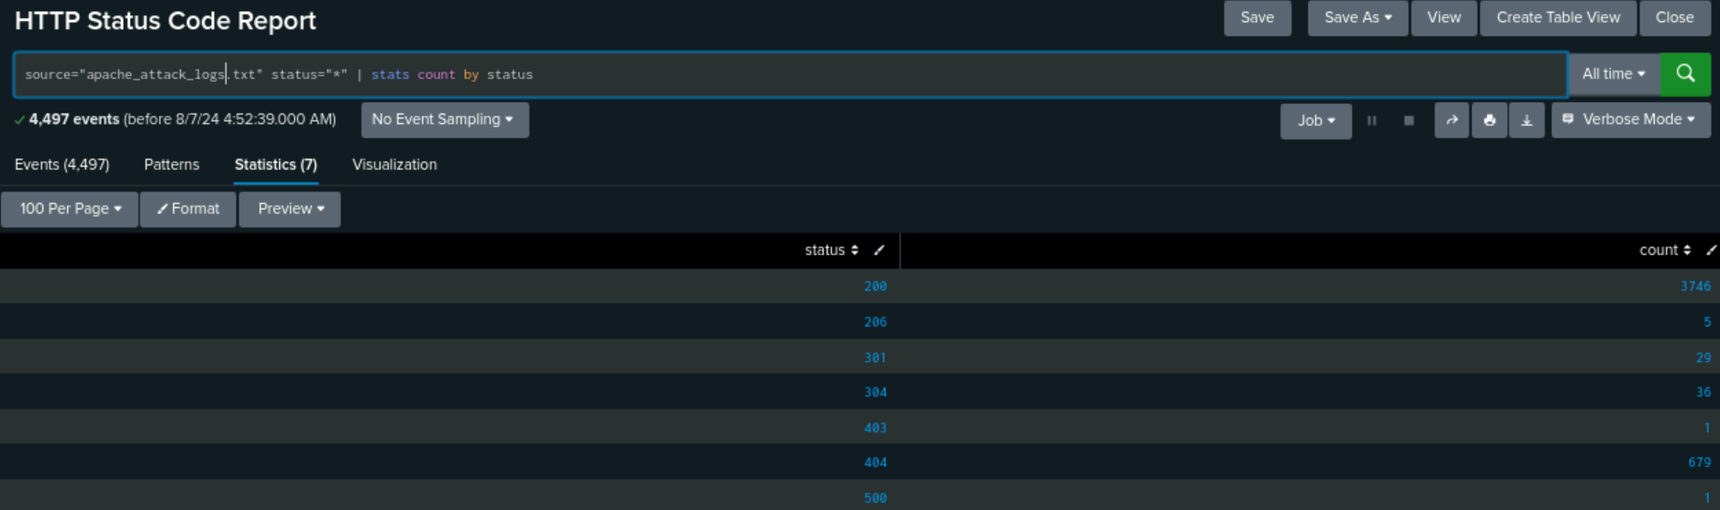
Screenshots of Apache Attack Logs

Slide 39
Summary and Future Mitigations
‹#›

Slide 40
Project 3 Summary
What were your overall findings from the attack that took place?
From 7:00 PM to 9:00 PM on March 25, 2020, there was a successful DDoS attack on vsi-company.com which was likely the result of PHP code injection and/or brute forcing. This reduced website functionality by approximately 75% and enabled the attackers to gain access to the Windows server as user_j. The attacks originated from Kharkiv, Ukraine.
To protect VSI from future attacks, what future mitigations would you recommend?
Refine alert thresholds for failed Windows activity to reduce false positives and ensure critical issues are detected.
Ensure all systems are updated and patched.
Immediately reset credentials for user_j. Require strong passwords for all users.
Limit permissions on back-end files.
Utilize input validation, multi-factor authentication, login attempt limits, rate limiting, and web application firewalls.
Consider geo-restriction for traffic from known high-risk regions.
Notes:
In conclusion, our findings show there was a successful DDoS attack on vsi-company.com between 7:00 PM and 9:00 PM on March 25, 2020 from attackers in El Salvador and the Ukraine. The flood of POST requests indicates that the most likely methods used were PHP code injection and brute forcing. The 75% reduction of GET requests during that time frame indicates a substantial impact on website functionality.
We also determined that on the same day, the attackers attempted to log into to VSI's Windows server as users a, j, and k, and were ultimately successful in gaining access to the server as user_j. To strengthen defenses against future attacks, several key mitigations are recommended:
(read slide) Limit permissions on back-end files as an added precaution to reduce the possibility of sensitive data being accessed in the event of a breach.

Slide 41
Thank You for Choosing Frog Squad Security, LLC
We sincerely appreciate the opportunity to partner with you in safeguarding your digital assets. At Frog Squad Security, LLC, our mission is to deliver exceptional cybersecurity solutions tailored to your unique needs. Your trust in our expertise is invaluable, and we are committed to maintaining the highest standards of security and service.
Should you have any questions or require further assistance, please do not hesitate to contact us. We look forward to continuing to support your security needs and ensuring the ongoing protection of your organization.
Thank you once again for your confidence in Frog Squad Security, LLC.
Sincerely,
Frog Squad Security

